Slide 1
STANDARDS
WHY DO WE NEED THEM?

Slide 2
EXAMPLES OF ESTABLISHED STANDARDS
The US Constitution
  The President
    The House of Representatives
    The Senate
FA Rule Book
  The Referee
    The Linesmen
    The "yellow card"

Slide 3
TYPICAL WEBSITE STANDARDS
Coding languages supported
  HTML5 and CSS3 ?
Support for legacy browsers
Security system that must be used
File formats supported
Preferred usability testing methods
Design standards
Screen size for design
Accessibility standards
Development methodology
  User Centred Design
  Agile Scrum
  Mobile-first

Slide 4
WRITING A WEBSITE STANDARD
Website governance
Website maintenance
  Publishing
  Quality Assurance
  Monitoring
  Change control
Website development
  Planning
  Content
  Design
  Testing
Website infrastructure
  Hosting

Slide 5
WORDING THE STANDARD
MUST
  The definition is an absolute requirement of the specification.
MUST NOT
  The definition is an absolute prohibition of the specification.
SHOULD
  There may exist valid reasons in particular circumstances to ignore a particular item, but the full implications must be understood
SHOULD NOT
  There may exist valid reasons in particular circumstances when the particular behaviour is acceptable or even useful, but the full implications should be understood
MAY
  Means that an item is truly optional.
From Request For Comments rfc2119

Slide 6
STANDARDS CHANGE
Standards develop over time
  Versions of HTML
Standards develop in response to external factors
  Technological innovation
    Morse's Rule
  Social change
  Legal factors
  Environmental considerations
    “Green” issues
  Government decisions
    Bi-lingual sites
    Accessibility

Slide 7
THE LAW SETS STANDARDS
Privacy and Data Protection
Libel and Criminal Damage
Freedom of Expression
Copyright
Electronic Commerce
  Electronic signatures, tax, consumer rights
Disability
Official Languages

Slide 8
HOW DO STANDARDS EMERGE?
Technology
  Feet or metres?
  Longitude
Motoring
  Drive on left or right?
  Height of bumper bars
  Driving licence
Communication
  Morse code
  "Roger", "Over" and "Over and out"
  VHS or betamax?
  Offline storage
  HTML

Slide 9
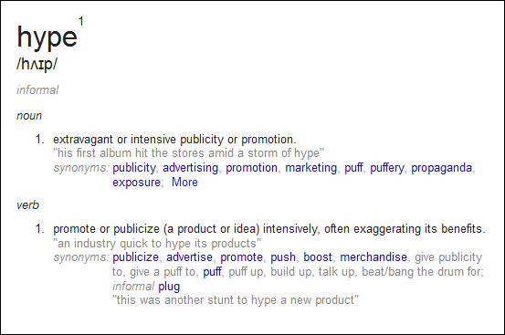
WHAT IS HYPE?

Slide 10
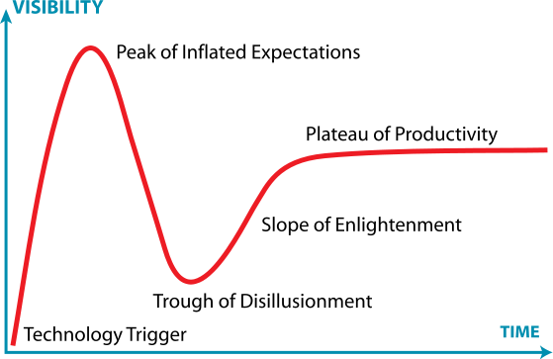
GARTNER HYPE CYCLE
Standards emerge
Standards develop
Lack of standardisation

Slide 11
FIVE PHASES IN ANY NEW INITIATIVE
"Technology Trigger"
  The breakthrough that generates significant interest.
  Multitude of competing standards
"Peak of Inflated Expectations"
  A frenzy of publicity typically generates over-enthusiasm and unrealistic expectations.
  Standards may emerge
"Trough of Disillusionment"
  Fails to meet expectations and quickly become s unfashionable.
"Slope of Enlightenment"
  Some businesses experiment to understand the benefits and practical application of the technology.
"Plateau of Productivity"
  Benefits become widely demonstrated and accepted
  Technology becomes increasingly stable and evolves in second and third generations.
  Standard stabilises

Slide 12
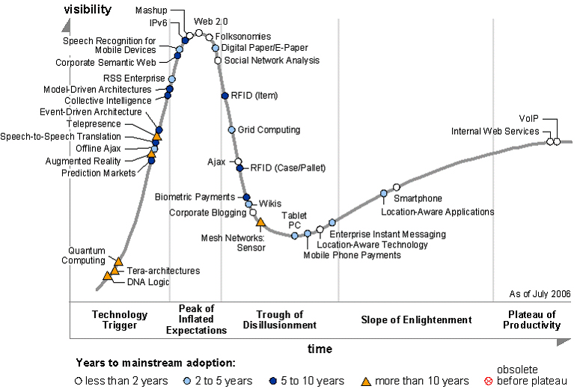
GARTNER HYPE CYCLE 2006

Slide 13
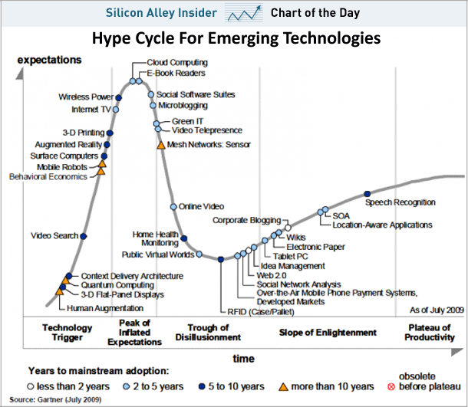
2009

Slide 14
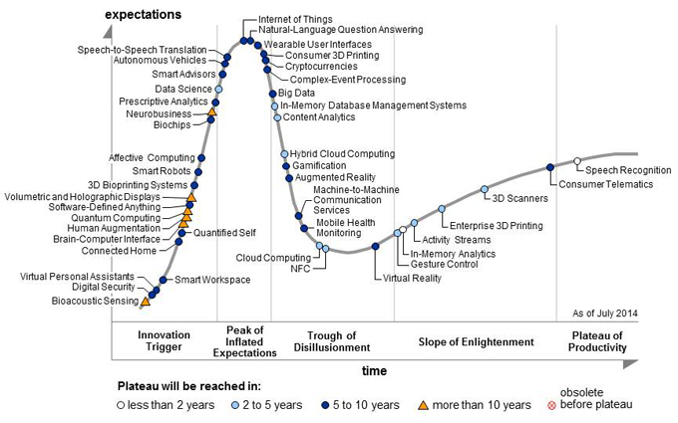
2014

Slide 15
FINALLY
If in doubt “conform to the norm”
  Do not invent your own way of doing online purchases – the shopping basket works!
  Have similar navigation to other sites.
Standards generally assist development
Changing standards can be disruptive

